Slide 1
Test Automation

Slide 2

Smart Commits
Process JIRA issues
Using smart commits change the status of an issue automatically
Comment – Normal comment about the code
Time – Time it took to complete task
Transition – Move task to done status
NOTE: A Smart Commit command must not span more than one line (i.e. you cannot use carriage returns in the command), but you can add multiple commands to the same line.
SOURCE: Process issues with smart commits | Jira Software Cloud | Atlassian Support

Slide 3

Test Complete
TestComplete is a functional automated testing platform developed by SmartBear Software. It gives testers the ability to create automated tests for Microsoft Windows Web, Android Operating system, and iOS applications. Tests can be recorded, scripted or manually created with keyword driven operations and used for automated playback and error logging.
SOURCE: https://smartbear.com/product/testcomplete/overview/

Slide 4

Coded UI
Coded UI can be particularly useful for functional tests. Coded UI Test ( CUIT) uses Visual Studio IDE to write scripts, as the recording can be done using Visual Studio. This testing platform is developed by Microsoft.
SOURCE: https://docs.microsoft.com/en-us/visualstudio/test/use-ui-automation-to-test-your-code?view=vs-2022

Slide 5

Appium
Appium is open source and it is written in node.js.
Appium supports Android and IOS and Windows apps (Using the WebDriver protocol)
Commonly used programming API's can be integrated.
Open Source
Selenium Web driver compatible
SOURCE: https://appium.io/

Slide 6

LoadRunner
Load Runner is a software testing tool and it is developed by Micro Focus. It is used to test applications, measuring system behavior and performance under load.
SOURCE: https://www.microfocus.com/en-us/products/loadrunner-professional/overview

Slide 7

Selenium
Open Source: Selenium allows users to share, extend, and modify the available code.
Support Languages: Selenium supports a range of languages, including Java, Perl,Python, C#, Ruby, Groovy, Java Script, etc.
Server Starting Not Required: A major benefit of automation testing with Selenium WebDriver is that you don’t need to start any server prior to testing.
Supports Operating Systems: Selenium can operate and support across multiple Operating Systems (OS) like Windows, Mac, Linux, UNIX, etc.
Support across browsers: Selenium provides support across multiple browsers, namely, Internet Explorer, Chrome, Firefox,
SOURCE: https://www.selenium.dev/

Slide 8

Selenium Setup Requirements
Python
Welcome to Python.org
ChromeDriver
https://chromedriver.chromium.org/downloads
Selenium Python plugin
1. Installation — Selenium Python Bindings 2 documentation (selenium-python.readthedocs.io)

Slide 9
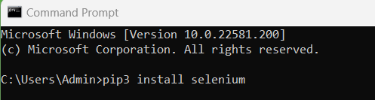
Selenium Setup
Remember to install on the version of python you plan to use
Install command line via pip
pip3 install selenium
Windows Users
C:\Python39\Scripts\pip.exe install selenium
SOURCE: 1. Installation — Selenium Python Bindings 2 documentation (selenium-python.readthedocs.io)

Slide 10
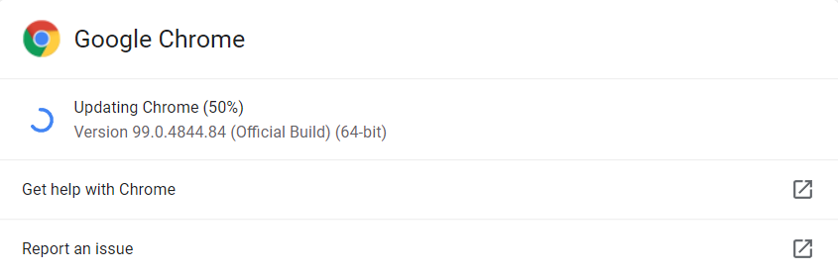
Selenium Setup
Check the version of chrome you are using
The chrome version must match your ChromeDriver

Slide 11
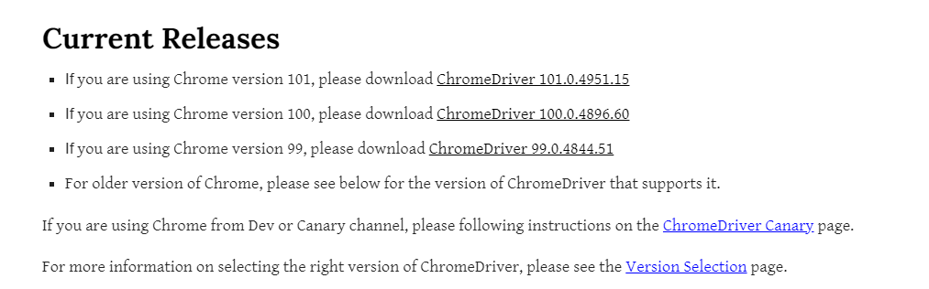
Selenium Setup
Ensure your chrome browser matches the ChromeDriver you are downloading
SOURCE: https://chromedriver.chromium.org/downloads

Slide 12
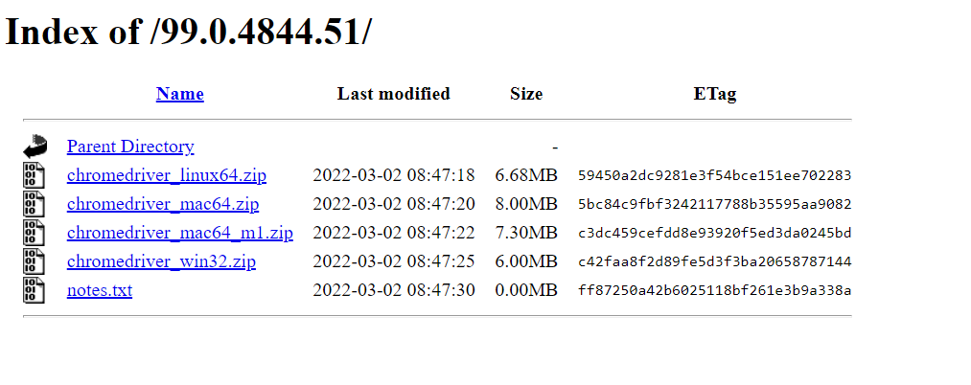
Selenium Setup
Chose the right ChromeDriver for your operating system
SOURCE: https://chromedriver.chromium.org/downloads

Slide 13
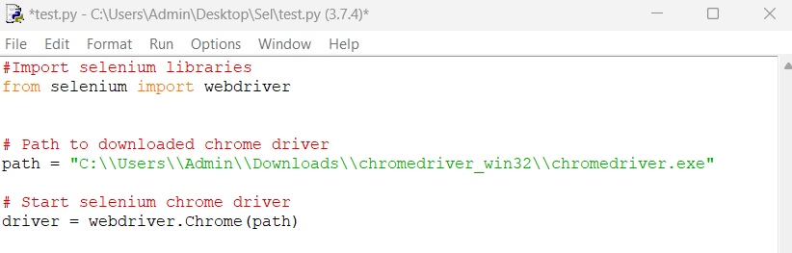
Selenium Setup
Import the webdriver from selenium
from selenium import webdriver
Add the location off your ChromeDriver
path = <Path to ChromeDriver>
Setup webdriver
driver = webdriver.Chrome(path)

Slide 14
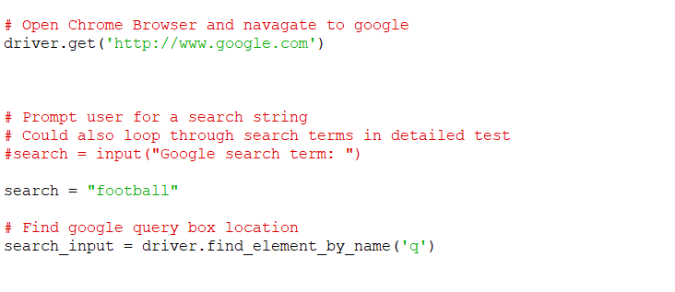
Selenium Setup
Navigate to website
driver.get('http://www.google.com')
Create search term
search = "football“
Could make a more robust test with loop
Could prompt user for adhoc tests
Find google query box
Variable name of query box

Slide 15
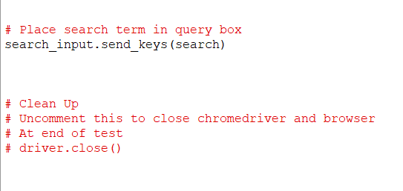
Selenium Setup
Send search term to google query
Clean up
Driver.close()

Slide 16

Questions
Next Lecture
Test Plan
Test Document
End Of Course Doc
Future Lectures
Deployment & Maintenance

